Slide 1
7.6 De Broglie Wavelength

Slide 2
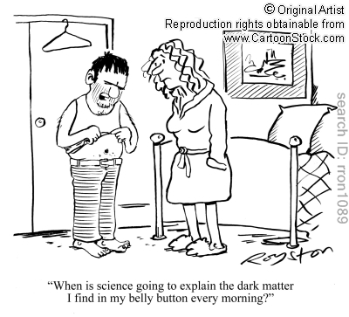
An example – Quantum physics

Slide 3
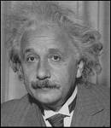
Light as particles and waves
In 1905 Einstein showed that the photoelectric effect could be understood if light were thought of as a stream of particles (photons). This seemed to contradict some other experiments that shows light travels as waves.
I got my Nobel prize for that.

Slide 4
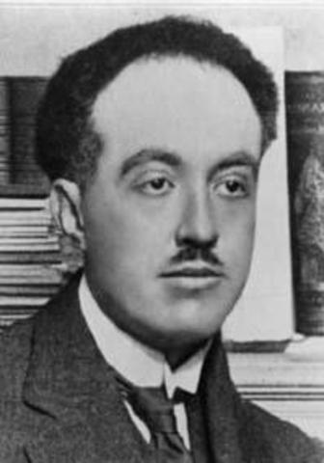
Louis de Broglie (in 1923)
If light can behave both as a wave and a particle,
I wonder if a particle can also behave as a wave?

Slide 5
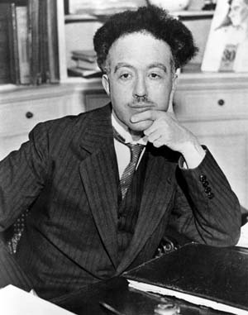
Louis de Broglie
I’ll try messing around with some of Einstein’s formulae and see what I can come up with.

Slide 6
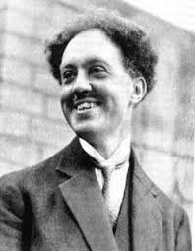
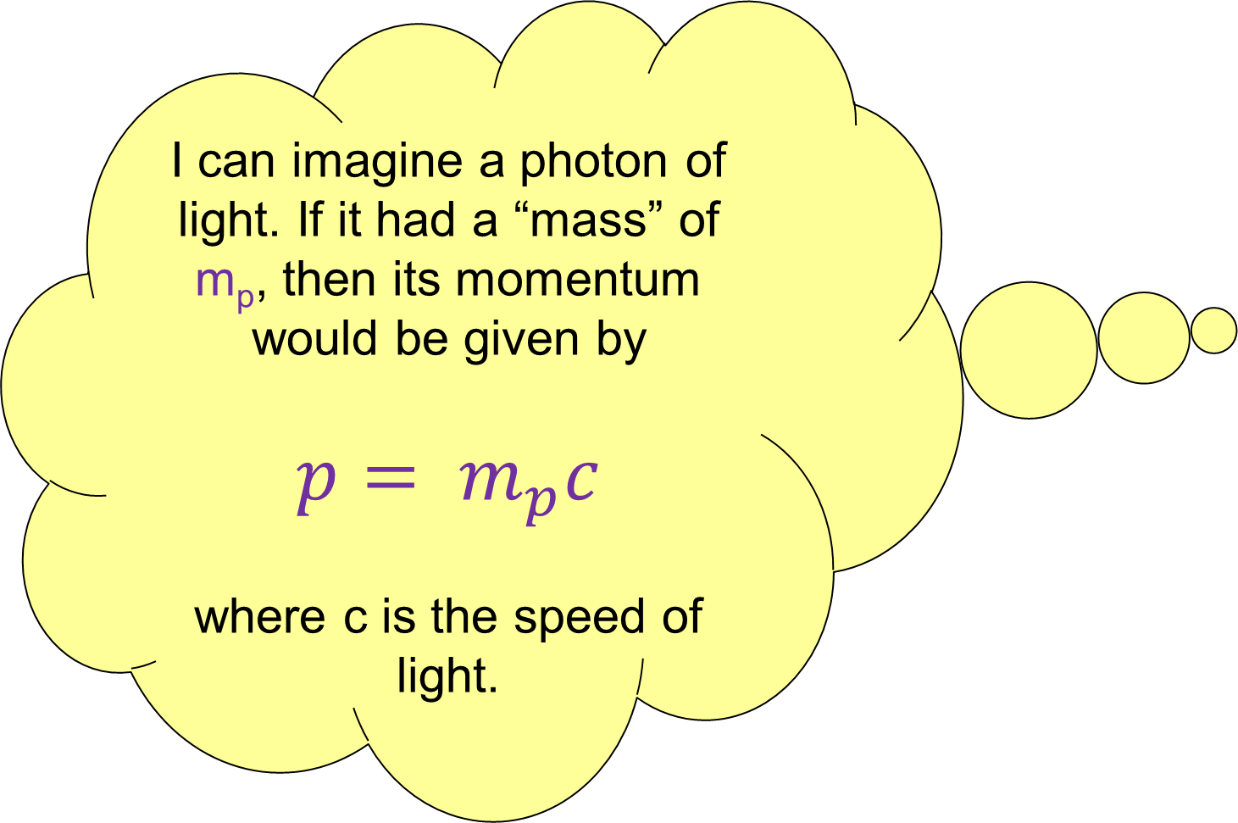
I can imagine a photon of light. If it had a “mass” of m_{p}, then its momentum would be given by
$$p= m_{p}c$$
where c is the speed of light.

Slide 7
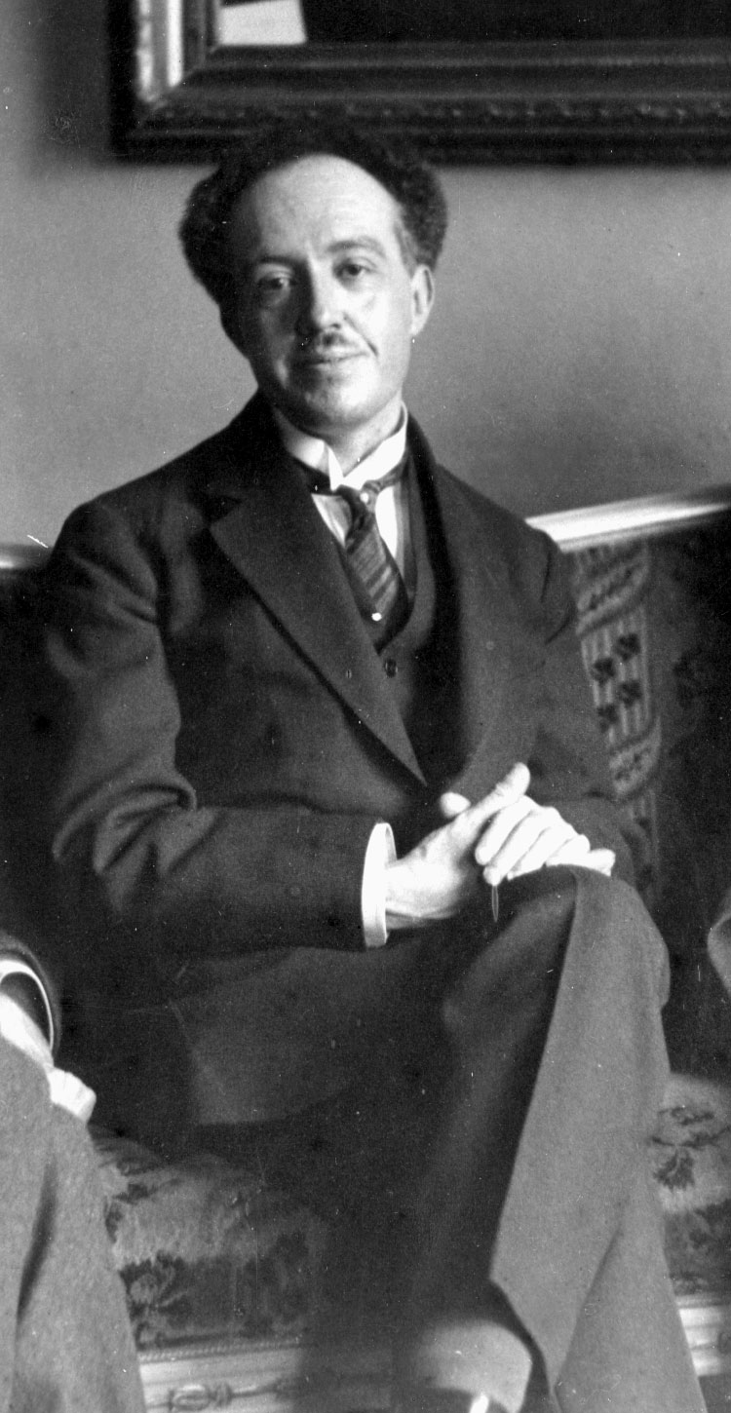
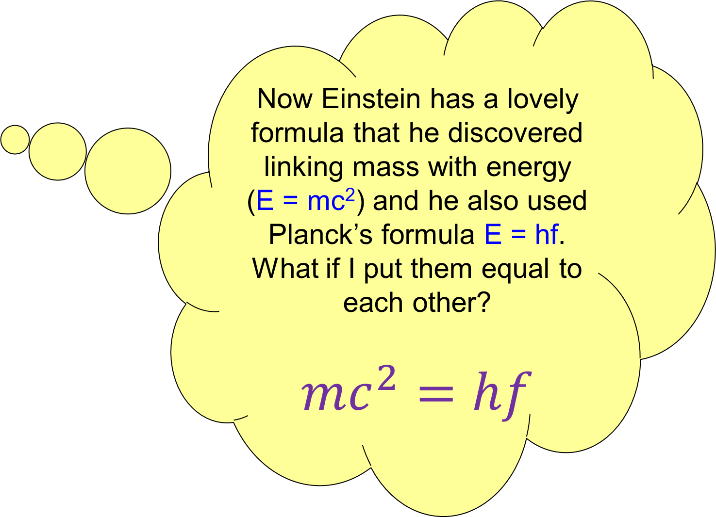
Now Einstein has a lovely formula that he discovered linking mass with energy
(E = mc²) and he also used Planck’s formula E = hf. What if I put them equal to each other?
$$mc^{2}=hf$$

Slide 8
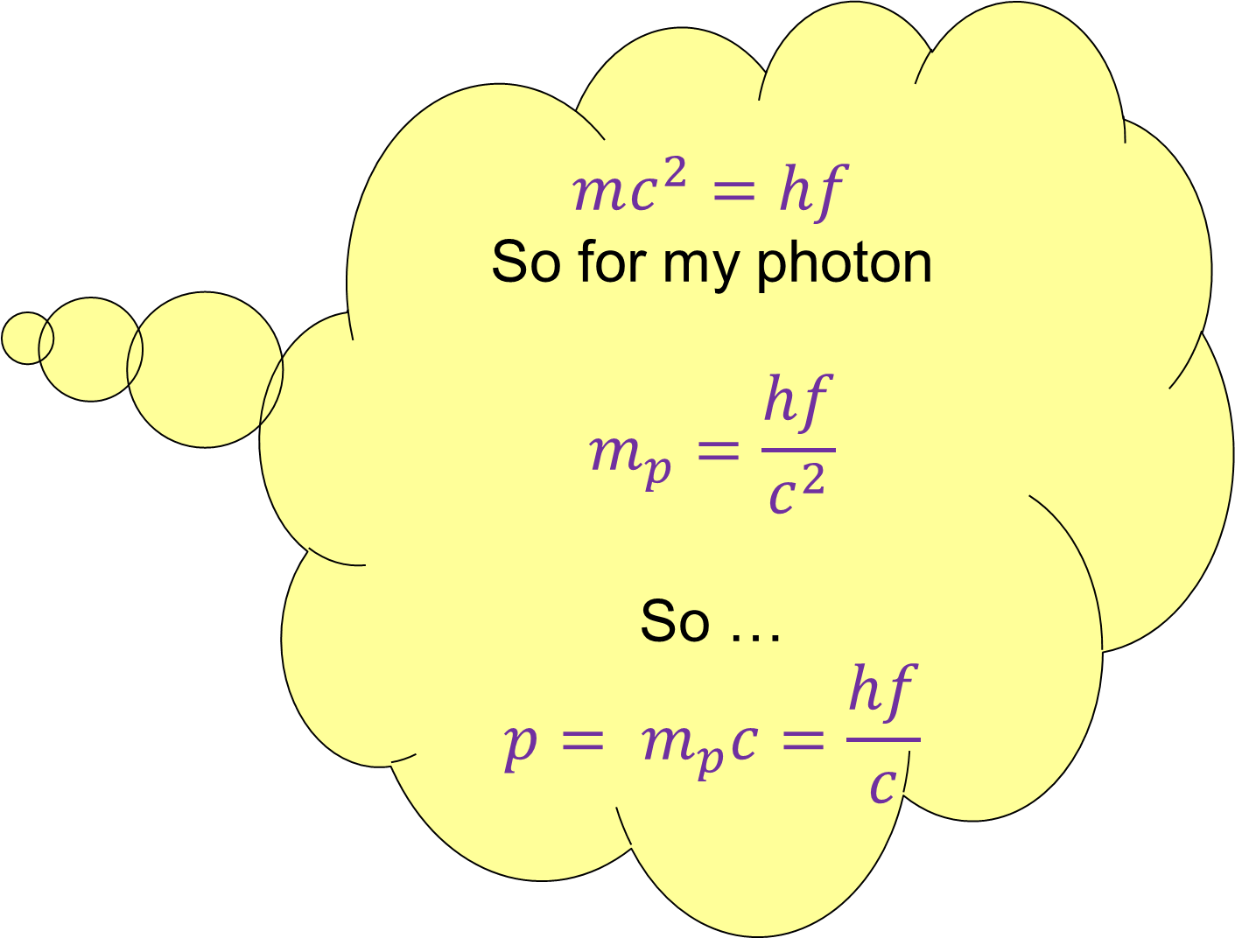
$$mc^{2}=hf$$
So for my photon
$$m_{p}=\frac{hf}{c^{2}}$$
So …
$$p= m_{p}c=\frac{hf}{c}$$

Slide 9

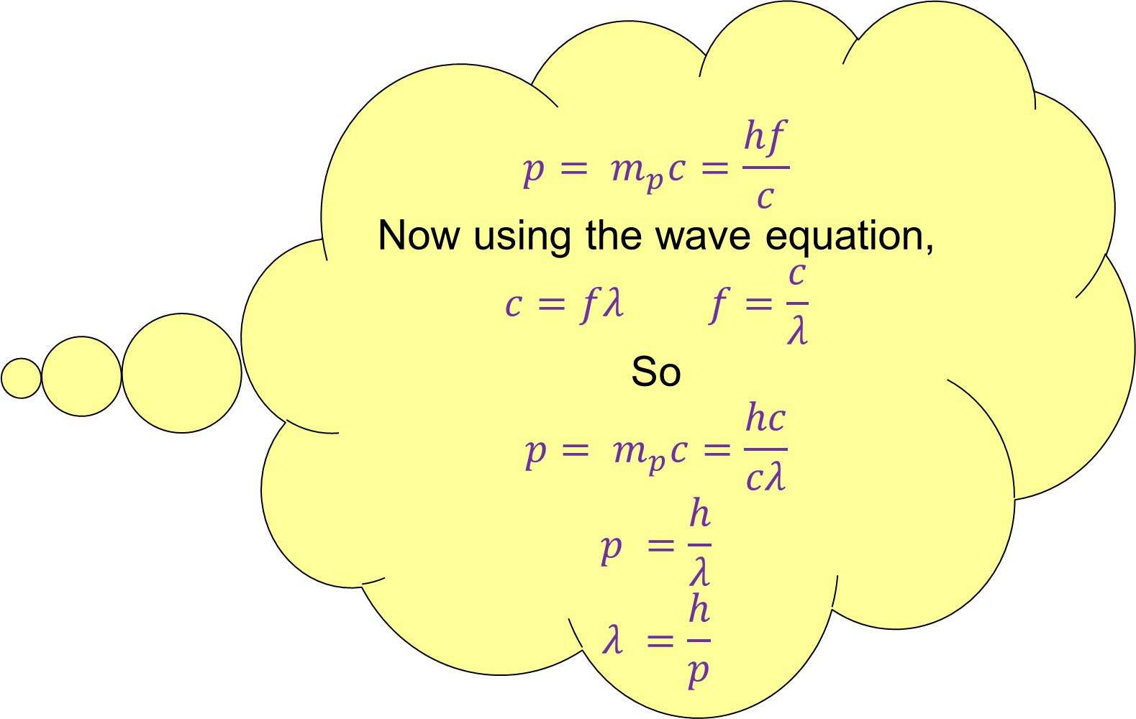
$$p= m_{p}c=\frac{hf}{c}$$
Now using the wave equation,
$$c=fλ f=\frac{c}{λ}$$
So
$${p= m}_{p}c=\frac{hc}{cλ}$$
$$p =\frac{h}{λ}$$
$$λ =\frac{h}{p}$$

Slide 10


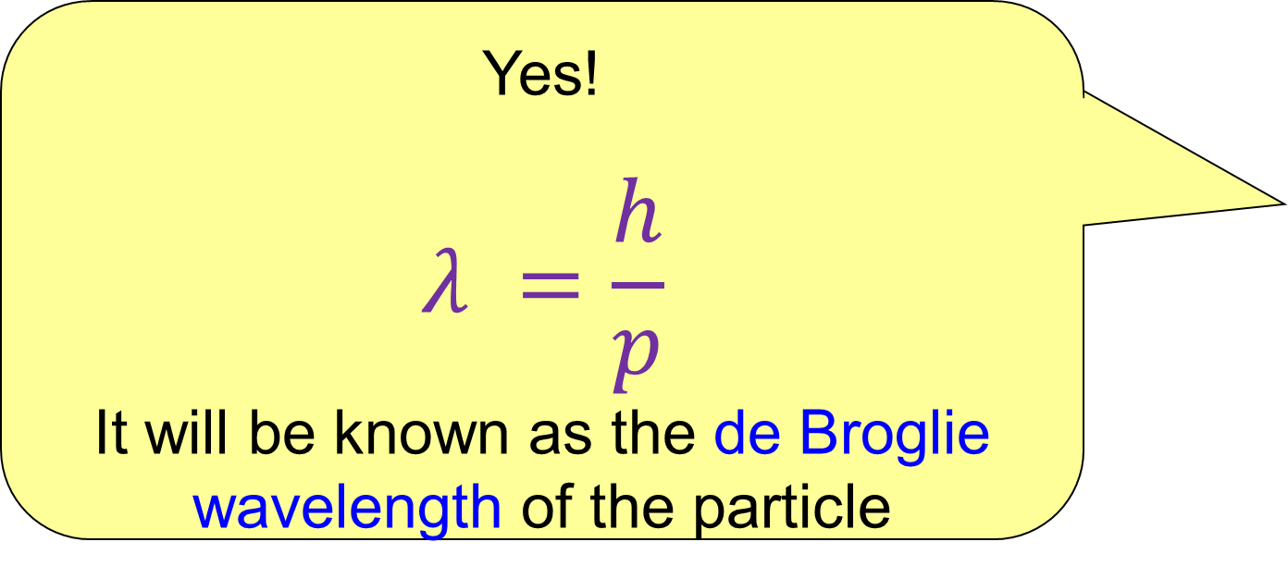
So you’re saying that a particle of momentum p has a wavelength equal to Planck’s constant divided by p?!
Yes!
$$λ =\frac{h}{p}$$
It will be known as the de Broglie wavelength of the particle

Slide 11

Confirmation of de Broglie’s ideas
De Broglie didn’t have to wait long for his idea to be shown to be correct.
In fact in 1929 I received a Nobel prize for my prediction of the wave nature of the electron.

Slide 12
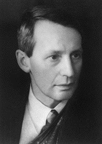
Confirmation of de Broglie
De Broglie’s hypothesis was confirmed independently by Clinton Davisson (USA) and George Thomson (UK) in 1927
Ironically my Dad (J.J.) had won a Nobel prize for demonstrating that the electron was a particle!

Slide 13
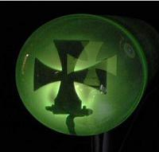
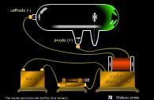
Behavior of Electrons
Particle behavior
cathode
anode

Slide 14

Electrons cast sharp shadows and are affected by magnetic and electric fields, unlike wave
Electrons must be Particles

Slide 15
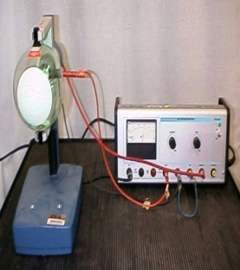

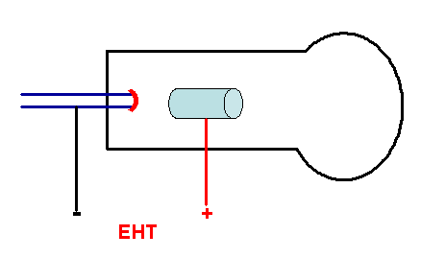
Wave Behaviour of electrons
Test: Can electrons be diffracted?
vacuum
heater
e
graphite target
YES, ELECTRONS DO HAVE A WAVE NATURE

Slide 16
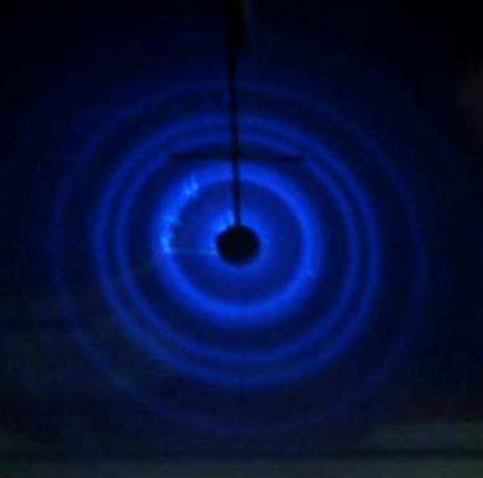
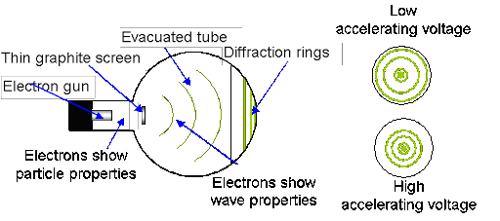
Electrons must be Wave-like
Electron diffraction can only be explained if electrons behave like waves

Slide 17
Electron Diffraction
Thomson and Davisson did similar experiments. They fired a beam of electrons at a nickel target.
Electron beam
Nickel target

Slide 18
Electron Diffraction
They observed strong reflection at some angles,
Electron beam
θ
Nickel target

Slide 19
Electron Diffraction
but not at others.
Electron beam
Nickel target

Slide 20
Electron Diffraction
They could find the crystal lattice separation from X-ray crystallography, and then measure the wavelength of the incident electrons. The results agreed totally with de Broglie’s predictions!
I knew they would!

Slide 21
Wave particle duality
We have seen that light can behave both as a wave (Young’s double slit experiment) and a particle (Einstein’s photo electric effect).
We have also seen that electrons can also behave as waves (electron diffraction predicted by de Broglie) and particles (J.J. Thomson)

Slide 22
Which is correct?
They both are!
It’s called wave-particle duality.
Light can behave both as a wave and a particle, and electrons (and other “particles”) can behave as both waves and particles.
But no experiment can ever show them behaving both as a wave and a particle at the same time!

Slide 23
Examples
What is the de Broglie wavelength of an electron travelling at 7 x 10⁶ m.s⁻¹?
λ = h/p
λ = 6.63 x 10⁻³⁴
9.11 x 10⁻³¹ x 7 x 10⁶
λ = 1.03 x 10⁻¹⁰ m (more or less)
This is similar to the average spacing between atoms in a crystal.

Slide 24
Examples
What is the de Broglie wavelength of a tennis ball (mass 58g) travelling at 10² m.s⁻¹?
λ = h/p
= 6.63 x 10⁻³⁴
0.058 x 10²
= 1.14 x 10⁻³⁴ m (more or less)
The tennis ball would have to interact with something of a similar size to demonstrate any wave properties!
The nucleus of an atom is around 10⁻¹⁵ m, a million, million , million times bigger than this!

Slide 25
Examples
How fast would a tennis ball need to be moving to have the same de Broglie wavelength as the electron in the previous example?
λ = h/p
= 6.63 x 10⁻³⁴
0.058 x 10²
= 1.14 x 10⁻³⁴ m (more or less)
The tennis ball would have to interact with something of a similar size to demonstrate any wave properties!
The nucleus of an atom is around 10⁻¹⁵ m, a million, million , million times bigger than this!

Slide 26
A harder example
Electrons are accelerated through a P.D of 54V and are directed at a Beryllium crystal with a spacing between atoms of 7.38 x 10⁻⁹m.
Calculate the de Broglie wavelength.
Energy of electrons = eV = ½ mv²
v = (2eV/m)^{½}
p = mv = (2eVm)^{½}
λ = h/p = h/ (2eVm)^{½} = 1.67 x10⁻¹⁰ m.

Slide 27
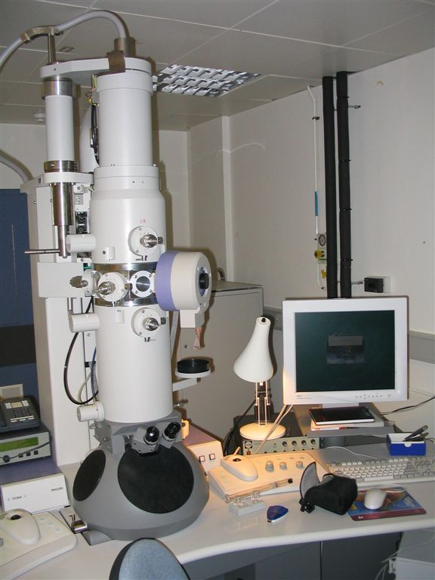
Electron microscope
This uses the wave nature of electrons to produce pictures of very small objects, too small to be imaged using visible light (which only has a wavelength of around 500 nm compared with electrons with a wavelength f around 0.1 nm).

Slide 28
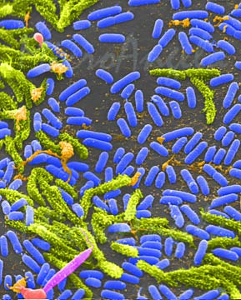
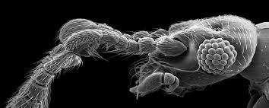
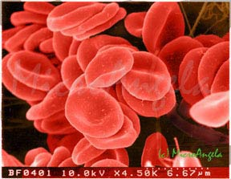

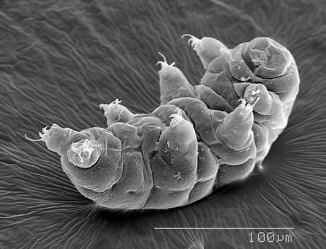
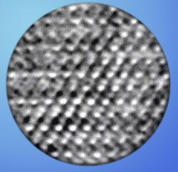
Electron microscope pictures
7.5μm
1μm
0.1nm

Slide 29
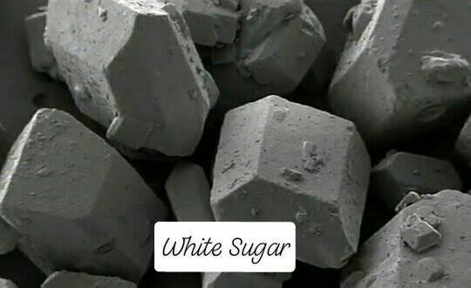

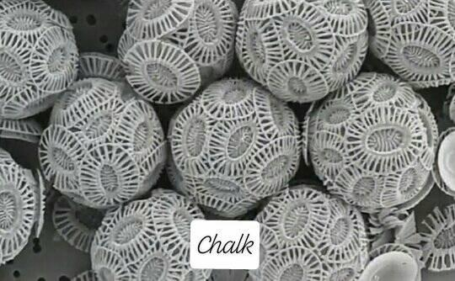
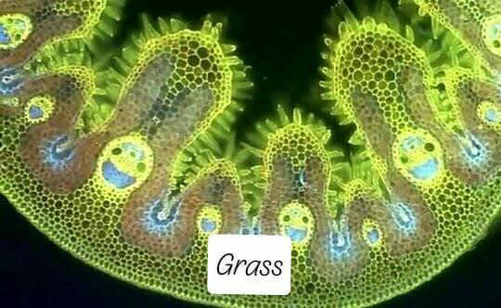

Slide 30

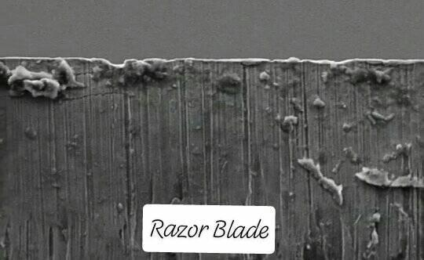
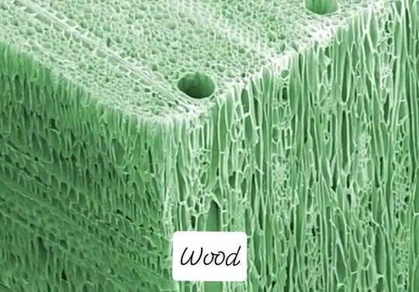
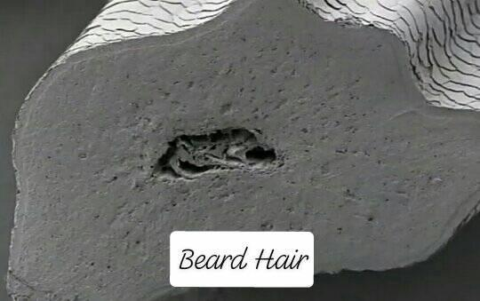

Slide 31

That’s it
Cool stuff eh?
Let’s try some questions

